Slide 1
Universal asynchronous receiver-transmitter
asynchronous serial communication
Start bit, Stop bit, Frame format
Buffer / FIFO

Slide 2
Non-blocking
not-waiting system
Data adds to buffer
Buffer send data to the transmit(Tx)

Slide 3
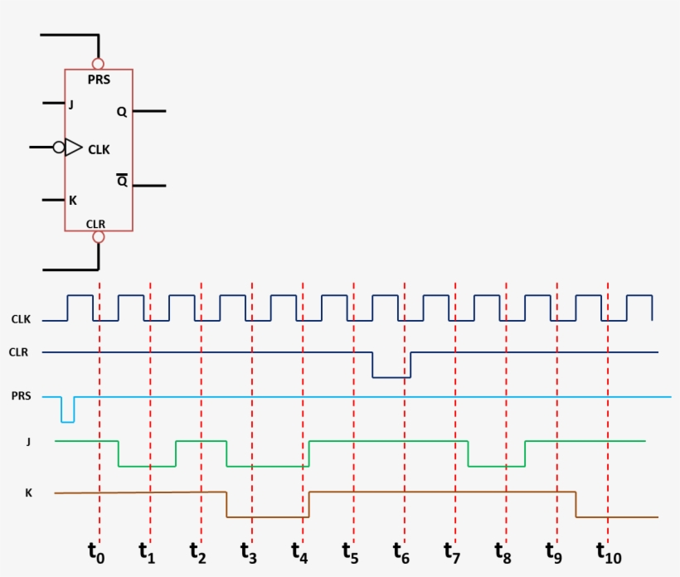
module non-blocking(
input wire clk, // Clock
input wire rst, // Reset đồng bộ
input wire d, // Dữ liệu đầu vào
output reg q // Dữ liệu đầu ra
);
always @(posedge clk) begin
if (rst)
q <= 1'b0; // Reset về 0
else
q <= d;
end
endmodule

Slide 4
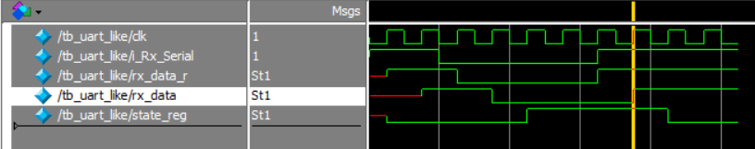
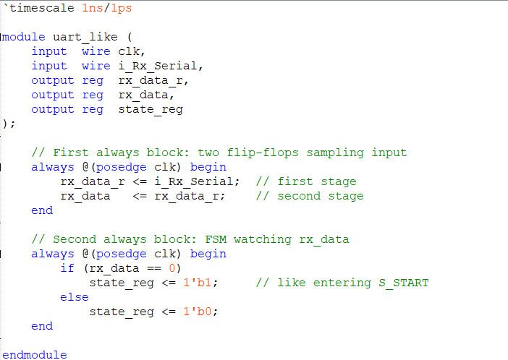
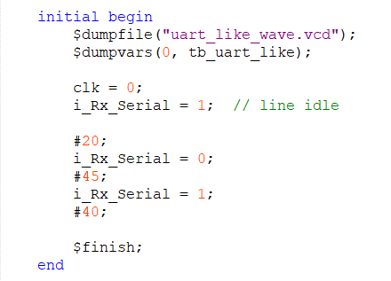

Slide 5
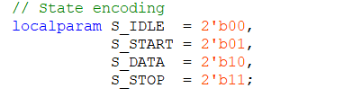
Preview about FSM
switch
switch
switch
condition
condition
condition
IDLE:
2’b00;
START:
2’b01;
DATA:
2’b10;
STOP:
2’b11;
condition
switch

Slide 6
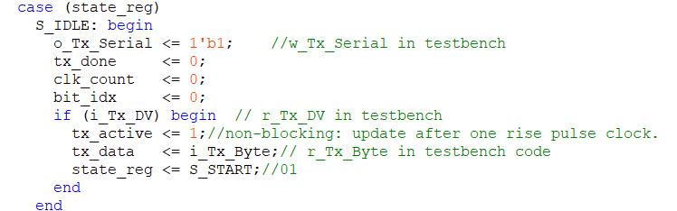
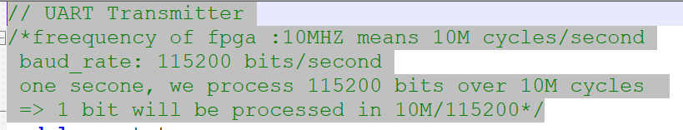
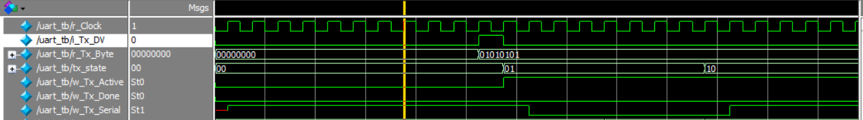
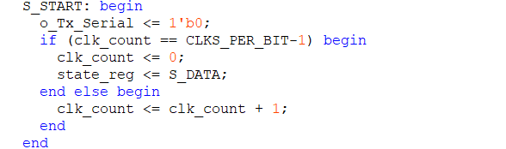
i_Tx_DV ==1;
IDLE:
2’b00;
START:
2’b01;

Slide 7
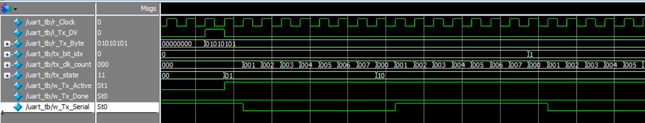
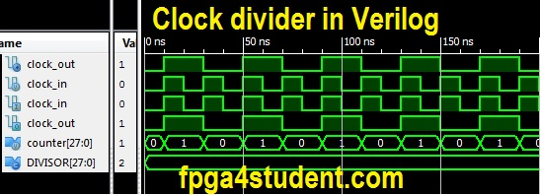
Presentation of baudrate on system

Slide 8
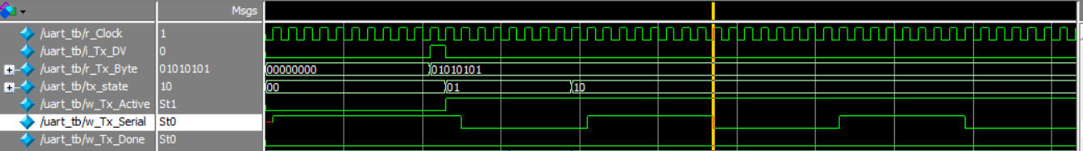
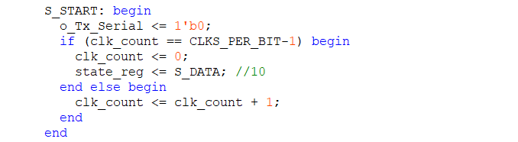

Clk_count == CLK_PER_BIT -1
i_Tx_DV ==1;
IDLE:
2’b00;
START:
2’b01;
DATA:
2’b10;
else Clk_count++

Slide 9
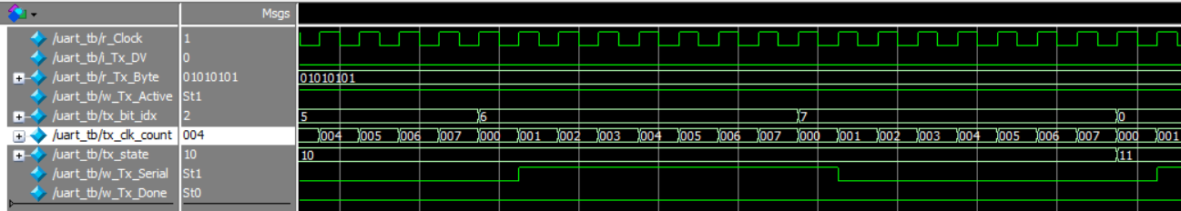
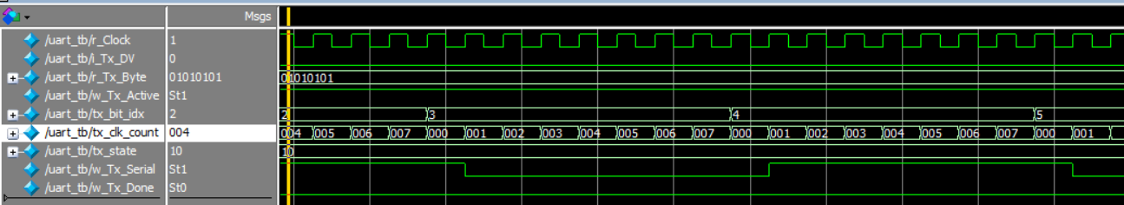
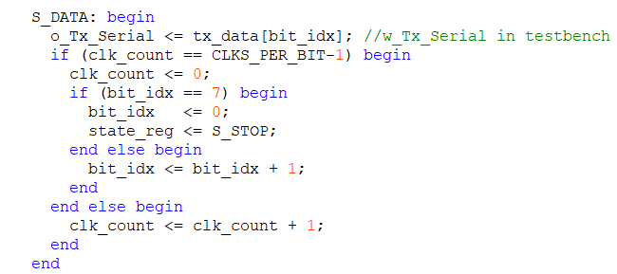
Clk_count == CLK_PER_BIT -1
Clk_count == CLK_PER_BIT -1
i_Tx_DV ==1;
START:
2’b01;
tx_bit_idx== 7
STOP:
2’b11;
IDLE:
2’b00;
DATA:
2’b10;
else Clk_count++
Clk_count++;(first)
tx_bit_idx++; (second)

Slide 10
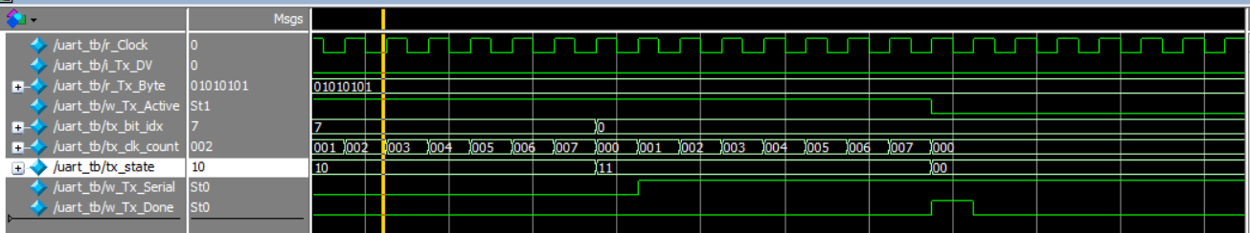
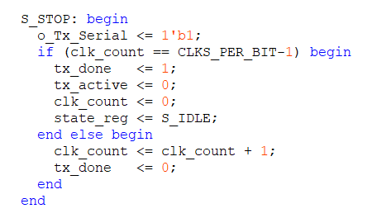

Slide 11
Clk_count == CLK_PER_BIT -1
Clk_count == CLK_PER_BIT -1
i_Tx_DV ==1;
START:
2’b01;
tx_bit_idx== 7
STOP:
2’b11;
IDLE:
2’b00;
DATA:
2’b10;
else Clk_count++
Clk_count++;(first)
tx_bit_idx++; (second)
Clk_count == optional ; tx_done =1;

Slide 12
